Slide 1


Green Pace
Security Policy Presentation
Developer: Antonio Sobalvarro

Slide 2

OVERVIEW: DEFENSE IN DEPTH
This model depicts security practices that will be followed and implemented in order to provide the best security to Green Pace.

Slide 3
THREATS MATRIX
This chart shows the industry standards applied to the priority and likelihood of threats; they are a general guideline.
Likely These threats are more common | Priority These should be resolved quickly
Low priority These can be resolved after the higher priority | Unlikely These threats are not as common

Slide 4
10 PRINCIPLES
Validate Input Data
Heed Compiler Warning
Architect and Design for Security Policies
Keep It Simple
Default Deny
Adhere to the Principle of Least Privilege
Sanitize Data Sent to Other Systems
Practice Defense in Depth
Use Effective Quality Assurance Techniques
Atop a Secure Coding Standard

Slide 5
CODING STANDARDS
1. Use valid references, pointers, and iterators to reference elements of a container
2. Do not cast to an out-of-range enumeration value
3. Do not attempt to create a std::string from a null pointer
4. Do not write syntactically ambiguous declarations
5. Properly deallocate dynamically allocated resources
6. Avoid information leakage when passing a class object across a trust boundary
7. Avoid cycles during initialization of static objects
8. Do not define an unnamed namespace in a header file
9. Do not let exceptions escape from destructors or deallocation functions
10. Do not modify namespaces

Slide 6
ENCRYPTION POLICIES
Encryption in Rest – This refers to the policy of using a key to encrypt data stored in a location where it is not currently used. Encrypting the data at this stage ensures that the data is kept private if it were to fall into the hands of an unwanted party, such as a hacker. The hacker would need the encryption key to view the data, without this key, the encrypted data is safe.
Encryption in Flight – This refers to the policy of encrypting data while it is being transmitted to another location, of “in flight”. Following this policy protects against hacking attacks that take advantage of data on the move by adding yet another layer of protection.
Encryption in Use – This policy refers to policy of actively encrypting data both at rest and in flight because not doing so can lead to vulnerabilities that can be exploited to gain access to the system. If an attacker illicitly accesses the system, they can then obtain the encryption key that would then allow them to further infiltrate the system.

Slide 7
TRIPLE-A POLICIES
Authentication – This is the process of verifying that the user is who they say they are; this allows only confirmed users to access the system. An example of this is using two-factor authentication.
Authorization – This policy refers to a user’s level of access in a system. A user might be able to add or delete files in the system, while another user might only be able to read information.
Accounting – This refers to keeping track of what each user is doing within the system. Following this policy can lead to finding out what each user accessed, when it was accessed, and what was done with the accessed data.

Slide 8
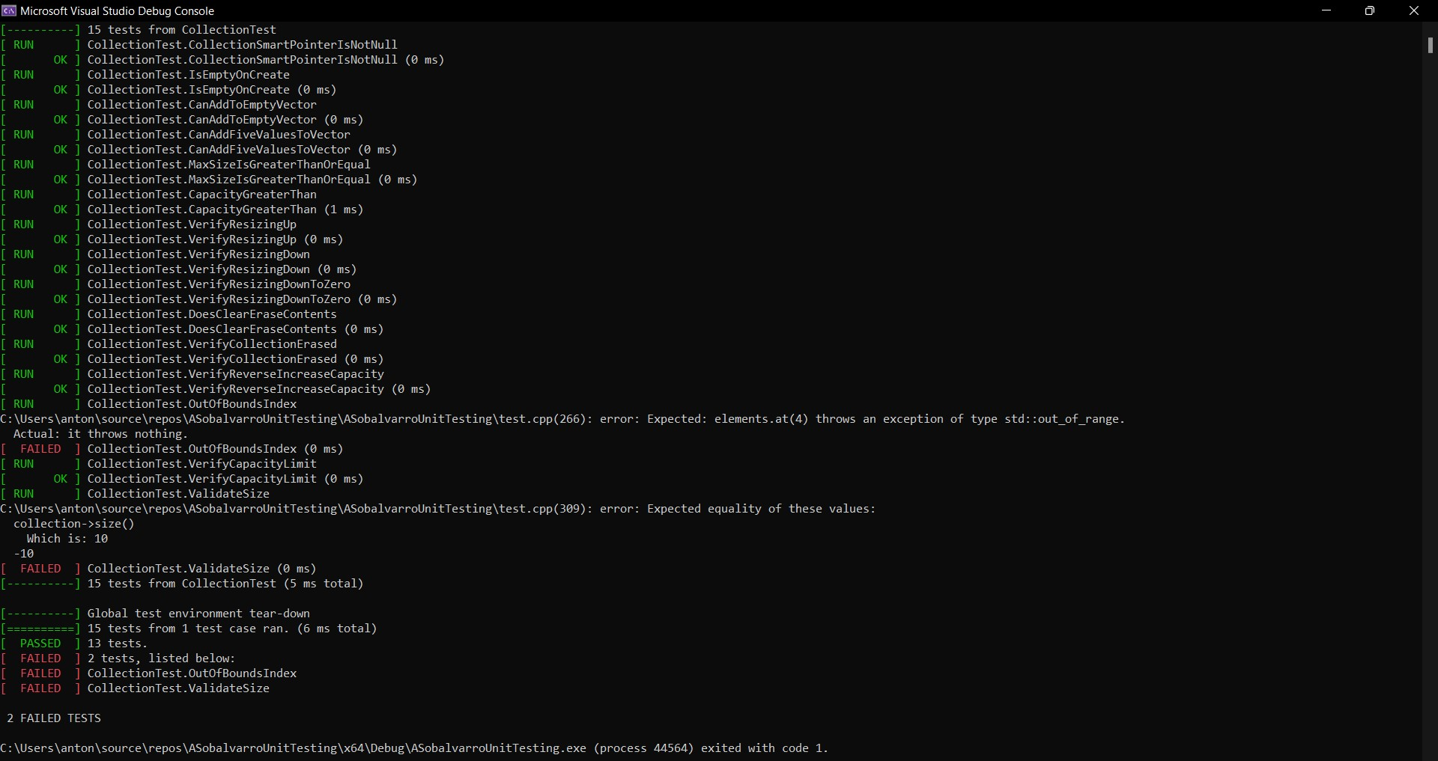
Unit Testing
Unit testing is performed to check that various security parameters are working as the should be. An example of this is testing to make sure that the system only accepts a set number of input characters, which can prevent certain vulnerabilities later on.

Slide 9

AUTOMATION SUMMARY

Slide 10
TOOLS
The DevSecOps pipeline is a circular set of security protocols that, when enforced, ensure that code is efficiently secure. Following these protocols also helps to maximize the efficiency of the entire system.
There are various external tools that can be used depending on the situation at hand. For example, during the testing and verifying phase of production, we can use Astrée. These tools help to detect vulnerabilities that would otherwise be undetected during production, among other functions, so their use is strongly encouraged.

Slide 11
RISKS AND BENEFITS
It is extremely difficult, if not virtually impossible, to build a 100% safe and secure system that protects against all attacks. Being aware of this is not a weakness, but a strength because it means that as a developer, you can take measures to try to continuously improve the system to counteract new and ever-evolving threats. As with everything, there are pros and cons to waiting to take taction and tacking immediate action when faced with threats. The biggest benefit to waiting is that money can be saved upfront, and a production cycle can proceed at a faster speed; the risk, however, is that the issue can become extremely difficult to manage as time passes. Acting now, by contrast, is more expensive and results in a slower process, but it produces fewer risks in the future thanks to code that is more secure.

Slide 12
RECOMMENDATIONS
Given that technology advances quickly, we must account for the rapid change of threats as well. Therefore, it is highly recommended that developers continue to educate themselves on these evolving threats and how to counter them in order to assure the long-term success of the system
Make extensive use of external tools to help detect vulnerabilities that might otherwise go undetected
Acting quickly against a threat is a policy to keep in mind at all times because it keeps a problem from snowballing into a bigger issue as time passes
One of the easiest ways to enforce security quickly and effectively is to encrypt all data in the system; this will keep the data safe and secure in case the system is infiltrated by an unwanted party
It’s also a good idea to perform unit testing as much as possible to ensure the system is working as it should; this is an easy way to maintain security

Slide 13
CONCLUSIONS
The importance of implementing Defense in Depth has been highlighted as well as the importance of incorporating security into a program in order to cement its long-term success. It’s also important to create, maintain, and follow a security program to assure that all developers can contribute to the security of the system. Implementing the policies and standards in this presentation can lead to a more successful system and future for Green Pace.

Slide 14
REFERENCES
No references to list
Thank you for attending my presentation!

